Slide 1
GREEDY ALORITHM
-Namrata Prasad
-181210032
-CSE 2nd Year

Slide 2
Description
Greedy is an algorithmic paradigm that builds up a solution piece by piece, always choosing the next piece that offers the most obvious and immediate benefit. So the problems where choosing locally optimal also leads to global solution are best fit for Greedy approach.

Slide 3
ALGORITHM
Algorithm Greedy (a,n)
//a[1:n]contains the n inputs
{
solution:=0;//initialize the solution.
for i:=1 to n do {
x:=Select(a);
if Feasible( solution, x)
then
solution:=Union(solution,x);
}
return solution;
}
The greedy algorithm usually consists of four functions:
A function that checks whether chosen set of items provide a solution.
A function that checks the feasibility of a set.
The selection function tells which of the items is the most promising.
An objective function, which does not appear explicitly, gives the value of a solution.

Slide 4
Applications
Activity Selection Problem
Job Sequencing Problem
Huffman Coding
Shortest Superstring Problem
Minimum and Maximum product subset of an array
Kruskal’s Minimum Spanning Tree
Prim’s Minimum Spanning Tree
Dijkastra’s Shortest Path Algorithm

Slide 5
Problem Statement 1
Shortest Superstring Problem
Given a set of n strings arr[], find the smallest string that contains each string in the given set as substring.
Example:
Input: arr[] = {"catg", "ctaagt", "gcta", "ttca", "atgcatc"}
Output: gctaagttcatgcatc

Slide 6
Greedy Approach
Let arr[] be given set of strings.
1) Create an auxiliary array of strings, temp[]. Copy contents
of arr[] to temp[]
2) While temp[] contains more than one strings
a) Find the most overlapping string pair in temp[]. Let this
pair be 'a' and 'b'.
b) Replace 'a' and 'b' with the string obtained after combining
them.
3) The only string left in temp[] is the result, return it.

Slide 7
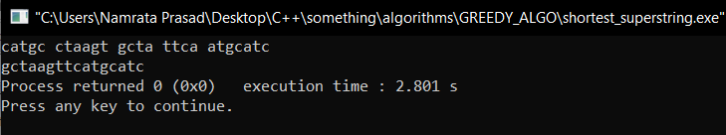
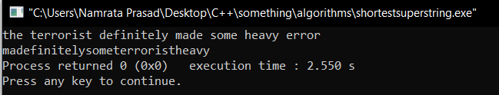
OUTPUTS
INPUT 1:
INPUT 2:

Slide 8
PROBLEM STATEMENT 2
BUY-SELL STOCK PROBLEM WITH TRANSACTION FEE
This is the famous problem for buying and selling stock to maximize profit when there is a transaction fee involved.
An array of integers is given, for which the i^{th} element is the price of a given stock on day i; and a non-negative integer fee
representing a transaction fee.
We may complete as many transactions as you like, but you need to pay the transaction fee for each transaction. We cannot buy more than 1 share of a stock at a time (i.e. we must sell the stock share before we buy again.)
We need to return the maximum profit we can make.

Slide 9
Algorithm
Let there are 2 states- s0 and s1.
s0 s1
There are 3 options: buy, sell, or rest.
being at state s0 we could rest or buy a stock
being at state s1 we could rest or sell a stock
On each step we would like to take an action that would maximize the profit. So, we can represent the state transition as follows:
s0 =max(s0, s1 + price[i]) // rest or sell from s1
s1 =max(s1, s0 - price[i] - fee) // rest or buy with a fee from s0
Time complexity: O(n)
Space complexity: O(1)
buy
sell

Slide 10

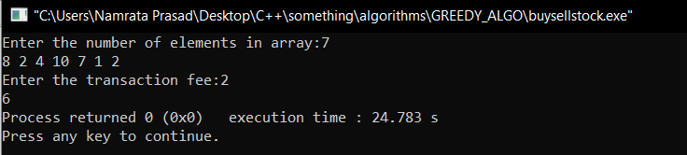
OUTPUTS
INPUT 1:
INPUT 2:

